Slide 1

Summary of Fake Reviews Method
Farnaz Tahmasebian
Notes:
http://www2.cs.uh.edu/~arjun/

Slide 2
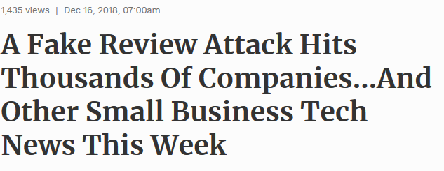


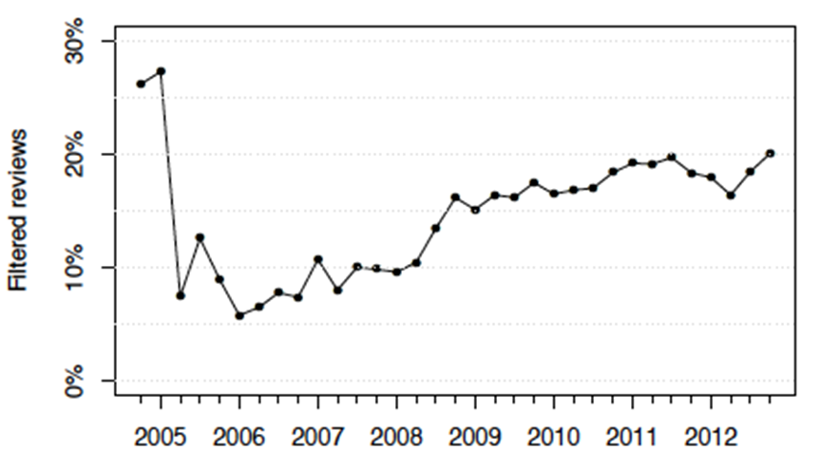
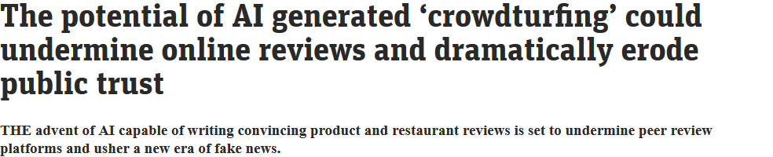
Problem
Reviews present a new way to learn about product quality
Around 20% reviews on Yelp are estimated to be faked by paid human writers, which is misleading when consumers are making decisions.
Impact of review: 1 star increase leads to a 5% increase in revenue for independent restaurants*
*Reviews, Reputation, andRevenue: The Case ofYelp.com, Harvard Study by M. Luca
Notes:
1 — A massive fake review attack has a big impact on small businesses.
The Local SEO community was recently the victim of a massive fake review attack that impacted small businesses globally when a collection of 37 profiles left over 3 million fake 4-star ratings. By the time Google removed them all about five days later, the average profile had left over 81,000 ratings for various businesses. Though it’s not clear who initiated the attack, most of the profiles had Vietnamese usernames, but the majority of the ratings were left for American SMBs. (Source: Search Engine Land)
Type of spams: Duplicate (easy, string matching)
Advertisements
Other easy-to-detect spams (all symbols, numbers, empty, etc.)
Untruthful (very hard, need machines to understand the intentions of the reviews)

Slide 3
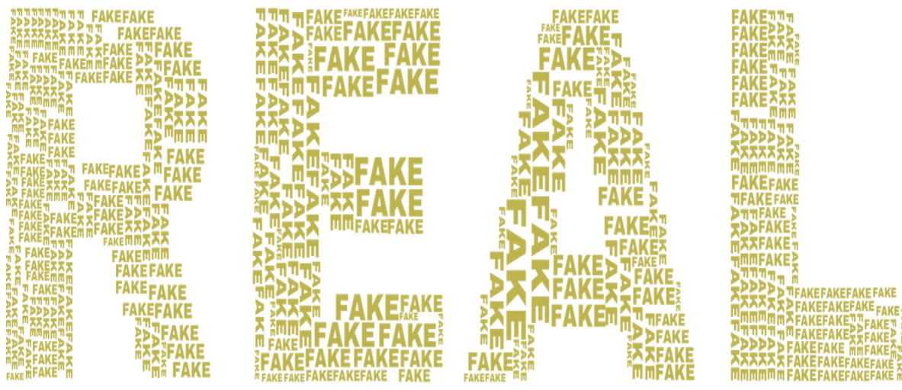
Can you Spot the fake reviews about Sydney restaurants?
1) “This place is amazing! The bartenders are absolutely amazing. The pasta is delicious and I love their pastries and it is amazing. I love the breakfast, friendly staff and the price is very reasonable. I have never had a bad experience here. I will be back for sure!”
2) “DO NOT WASTE YOUR TIME AND MONEY! The absolute worst service I have ever experienced. This place is a joke. The waitress was rude and said she would put the manager to come out but never happened. I wish I could give zero star.”
3) “A disappointing experience. Totally overpriced for what you get, unfriendly and slow service, average food. Definitely not worth the money.”
4) “I opted for the BBQ pork laksa and it was served in a matter of minutes for a measly $12.00. The BBQ pork was delicious and the laksa was piping hot with a slight chilli hit. I also chose 2 types of noodles for my soup because 2 is better than 1. I would have liked a few more veggies but the serving was generous enough.”
5) “I was here for a weekend brunch and the food was OK. I love the pizza that is a chain restaurant. I think the service is excellent. I had the spaghetti and they were very good and the hot dog was good. I got the red velvet chocolate cake special which was very good but the service was a little slow. The food was good, but not up to par with other places nearby.
* Generated by Prof Zhao and his team

Slide 4

Can you Spot the fake reviews about Sydney restaurants?
1) “This place is amazing! The bartenders are absolutely amazing. The pasta is delicious and I love their pastries and it is amazing. I love the breakfast, friendly staff and the price is very reasonable. I have never had a bad experience here. I will be back for sure!”
2) “DO NOT WASTE YOUR TIME AND MONEY! The absolute worst service I have ever experienced. This place is a joke. The waitress was rude and said she would put the manager to come out but never happened. I wish I could give zero star.”
3) “A disappointing experience. Totally overpriced for what you get, unfriendly and slow service, average food. Definitely not worth the money.”
4) “I opted for the BBQ pork laksa and it was served in a matter of minutes for a measly $12.00. The BBQ pork was delicious and the laksa was piping hot with a slight chilli hit. I also chose 2 types of noodles for my soup because 2 is better than 1. I would have liked a few more veggies but the serving was generous enough.”
5) “I was here for a weekend brunch and the food was OK. I love the pizza that is a chain restaurant. I think the service is excellent. I had the spaghetti and they were very good and the hot dog was good. I got the red velvet chocolate cake special which was very good but the service was a little slow. The food was good, but not up to par with other places nearby.”
* Generated by Prof Zhao and his team

Slide 5
Fake Review Detection
Detect fake reviews written by human (Crowdsourced or Expert Generated):
ML-based Review filter
Employs the language processing method to detect unusual patterns of text, writing style, and formatting.
Detect the fake reviews generated by AI

Slide 6
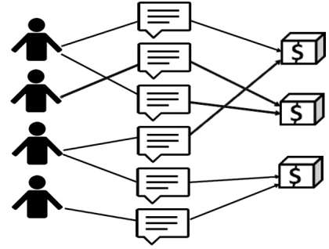
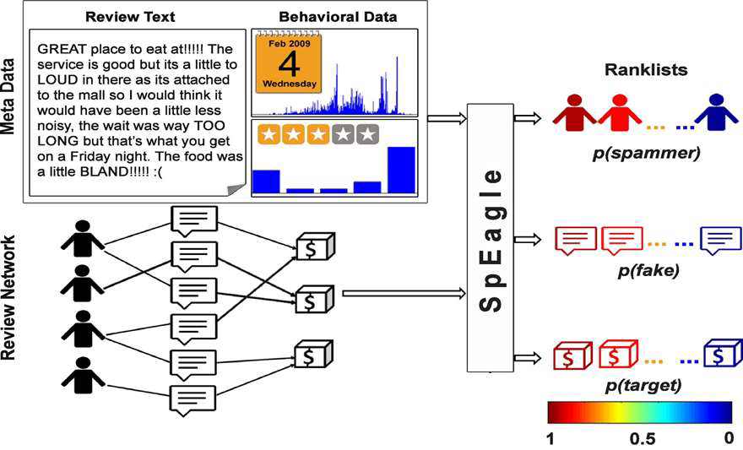
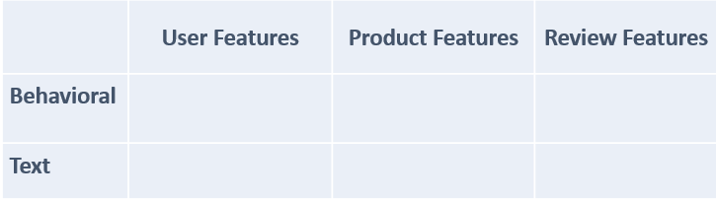
Fake Review Detection written by human
Related to:
Review
Product
Reviewer,
Meta data
Such as network
behaviors
Extracting Features
SVM/NB/LR
Detect fraudulent reviews
Notes:
Jindal et al. [3] first introduced deceptive opinion spam problem as a widespread phenomenon and showed that it is different from other traditional spam activities. They built their ground truth dataset by considering the duplicate reviews as spam reviews and the rest as nonspam reviews. They extracte features related to review, product and reviewer, and trained a Logistic Regression model on these features to find fraudulent reviews on Amazon.
Wu et al. [39] claimed that deleting dishonest reviews will distort the popularity significantly. They leveraged this idea to detect deceptive opinion spam in the absence of ground truth data. Both of these heuristic evaluation approaches are not necessarily true and thorough.
Yoo et al. [19] instructed a group of tourism marketing students to write a hotel review from the perspective of ahotel manager. They gathered 40 truthful and 42 deceptive hotel reviews and found that truthful and deceptive reviews have different lexical complexity.
Ott et al. [4] created a much larger dataset of 800 opinions by crowdsourcing 3 the job of writing fraudulent reviews for existing businesses. They combined work from psychology and computational linguistics to develop and compare three approaches for detecting deceptive opinion spam.
On a similar dataset, Feng et al. [33] trained Support Vector Machine model based on syntactic stylometry features for deception detection.
Li et al. [18] also combined ground truth dataset created by Ott et al. [4] with their employee (domain-expert) generated deceptive reviews to build a feature-based additive model for exploring the general rule for deceptive opinion spam detection.

Slide 7
Extracting Features
Similarity feature:
Captures inter-sentence similarity within a review at the word level.
It is computed as the maximum cosine similarity between unigram features among all pairs of sentences
Spammers likely to copy reviews across similar product. Choose maximum similarity to capture worst spamming behavior.
Lots of positive reviews left within a short time-frame, often using similar words and phrases
Multiple reviews using similar language and listing the same benefits
Structural features :
Individual features include the number of words, the number of sentences, the average sentence length (# of words) and the average word length (# of characters).
Syntactic features :
Captures the linguistics properties of the review based on parts-of-speech (POS) tagging.
Features include (distinct) percentages of nouns, verbs, adjectives and adverbs, first personal pronouns, and second personal pronouns
Negative fake reviews contained less spatial information and had a larger verb-to-noun ratio than truthful reviews.

Slide 8
Extracting Features
Semantic features :
Captures the subjectivity and sentiment of the reviews. Features include percentage of subjective words, percentage of objective words, percentage of positive words and percentage of negative words.
Deception words in fake reviews indicates projection in positive light. CDF of positive(4-5 stars) reviews among all reviews is plotted to illustrate analysis.
Lots of 5 star reviews with really short content – generally when somebody is delighted enough to leave a 5 star review, they’ll wax lyrical about the product with lots of detail
LIWC features : The Linguistic Inquiry and Word Count (LIWC) software is a widely used text analysis tool in the social sciences.
It categorizes ∼4,500 keywords into ∼68 psychological classes (e.g., linguistic processes, psychological processes, personal concerns and spoken categories).
Use the percentage of word count in each class as a feature, and exclude the features already included in the previous groups.

Slide 9
Behavioral:
Spammers mostly like to give extreme ratings(1 or 5) in order to boost ratings to demote or promote products
Posting many reviews a day is also abnormal.
Spammers are usually not longtime members of site.
Post reviews with high rating under different names in a short time
The results: in a short time, many reviewers wrote only one review with a very high rating
The correlations between rating and volume of (singleton) reviews is the key feature of singleton review spamming
Standard deviation of ratings

Slide 10
FAKE Review Detection
Linguistic n-gram features and supervised learning
Poor performance of n-grams for Yelp data because spammers according to Yelp filter used very similar language in fake review as non-fake review : linguistically very similar
For AMT data, word distribution of fake and non-fake reviews are very different, which explains the high accuracy using n-gram.
Notes:
[1] Mukherjee et al : http://delivery.acm.org/10.1145/2490000/2487580/p632-mukherjee.pdf
[2] Mukherjee, A., Liu, B. and Glance, N. 2012. Spotting Fake Reviewer Groups in Consumer Reviews. WWW (2012).
Using only Bigram features : accuracy of 89.6% on AMT data. [1]
Using same n-gram features : accuracy of 67.8% on Yelp Data.[2]
Class distribution of Yelp data is skewed – imbalanced data produces poor model.(Chawla et al, 2004)
Good model for imbalanced data – under sampling. (Drummond and Holte, 2003)
KL(F||N) Definition implies that words having higher probability in F and very low
probability in N contribute most to KL-Divergence.
Yelp fake review data shows KL(F||N) is much larger than KL(N||F) and ΔKL>1.

Slide 11
Observations
“(a) Deceptive reviews contain more words.
(b) Deceptive reviews are less complex.
(c) Deceptive reviews are less diverse.
(d) Deceptive reviews contain less self-references.
(e) Deceptive reviews contain a greater number of references to the hotel brand.
(f) Deceptive reviews contain a greater percentage of positive words.
(g) Deceptive reviews contain a smaller percentage of negative words.”
Notes:
Hypotheses (e–g) were confirmed, while (a–d) were not. In fact, the opposite hypotheses to (b) and (d) received
support: fake reviewers used more complex language and more self-references than truthful reviewers. ese results
imply that fake reviews may differ from other types of deception by oen being conducted by experts. Further, based
on O et al.’s results [128, 129], it seems likely that (f–g)’s success was due to the reviews’ promotional nature, and
would plausibly not be replicated on negative review data.

Slide 12
Challenge in DataSet
largest corpus of elicited fake reviews has been compiled by Ott et al. and contains 400 fake and 400 truthful reviews of both the positive and negative kind.
The Yelp provides a corpus of filtered reviews suspected to be fake

Slide 13
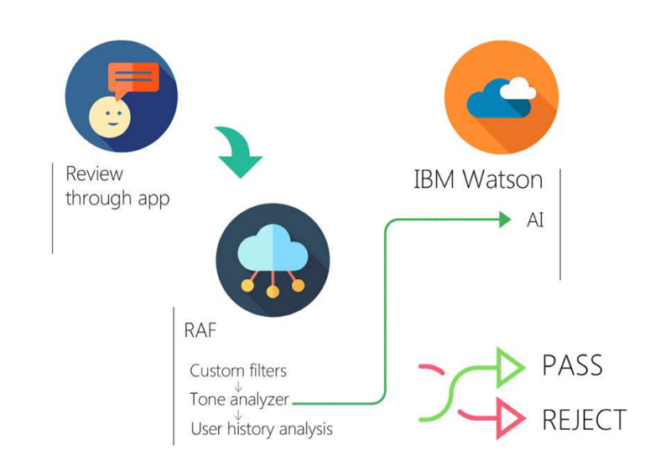
IBM Watson
Tone analyzer feature of IBM Watson, is able to automatically determine an emotional component of reviews.
‘Oh, this place sucks, such a bullshit, never ever again shall I be back here!!’
Tone Analyzer will instantly be able to detect suspicious features and suggest this review to be fake, using such criteria as:
Anger, Disgust, Sadness levels, Language Style and Social tendencies.

Slide 14
Fake review detectors
Fakespot
Analyse and sort product reviews on Amazon, Ebay
Analyzes the reviews in order to identify repeated words and phrases, frequency, dates, purchasing patterns and verified purchases to produce a list of reviews which are likely to be fakes.
ReviewMeta
Analyze millions of reviews in order to help you choose which ones to trust.
System will produce a result of ‘Pass’, ‘Warn’ or fail to help guide a buyer’s decision.
Analyze reviews based on language used within reviews, frequency of reviews, how soon after listing reviews are received and the number of reviews which are unverified.
The Review Index
Analyses a product’s link to produce an educated guess as to the authenticity of the product’s reviews.
The system will then produce a summary of the number of reviews, the number which are unverified and will also include a written summary noting whether or not recurring patterns have been detected which may suggest fake reviews.
Although a little more basic than Fakespot.com and Reviewmeta.com

Slide 15
AI Generated Fake Reviews
Notes:
http://www2.cs.uh.edu/~arjun/

Slide 16
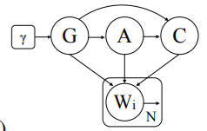
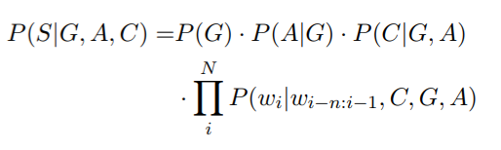
AI generated fake reviews (Hovy)
Generator: Hovy automatically generated fake reviews using a 7-gram Markov chain trained with data from the review site Trustpilot.
Detector: For classification, he used logistic regression with word n-grams (1 - 4) as features.
Notes:
The Enemy in Your Own Camp: How Well Can We Detect Statistically-Generated Fake Reviews – An Adversarial Study
Adding such meta-information to the model significantly improved its ability to fool the classifier.
However, while exact copies of training reviews were removed, a 7-gram model will likely reproduce large chunks of the training data. Duplicate or similarity detection between the training data and the generated reviews was not conducted by Hovy.
n the generative story of this model, we firstdraw a user from one of the two genders in ourdata, select an age based on gender-specific agedistributions, and choose a review category depen-dent on the two pr
evious variables. We then thengenerate a sentence conditioned on all of these set-tings and the Markov horizon.
nitially, we would like to establish whetherconditioning LMs on demographic informationhas any effect on detection. For this purpose,we compare the performance of the logisticregression model on (1) a test set including fakereviews generated by an unconditioned 7-gramLM and (2) a test set whose fake reviews havebeen conditioned on meta-information. In bothcases, the detector has only access to the basefeatures, i.e., ignores demographic information.This is equivalent to a situation where the judgecan only see the text, not the meta information.

Slide 17
AI generated fake reviews (Yao et al. )
Yao et al. generated fake reviews with a character-level Recurrent Neural Network (RNN) trained with restaurant reviews from Yelp.
Were unable to distinguish RNN-generated reviews reliably from those in the Yelp corpus,using:
Linear SVMs with various linguistic features,
Plagiarism detection method Winnowing ,
Human evaluators from Amazon Mechanical Turk
Defence against their RNN-generated fake reviews:
Statistical differences in character distributions between generated reviews and the training corpus.
Notes:
Yuanshun Yao, Bimal Viswanath, Jenna Cryan, Haitao Zheng, and Ben Y. Zhao. 2017
(In Proceedings of the 2017 ACM SIGSAC Conference on Computer and Communications Security (CCS '17). ACM, New York, NY, USA, 1143-1158. DOI: https://doi.org/10.1145/3133956.3133990)
Automated Crowdturfing Attacks and Defenses in Online Review Systems

Slide 18
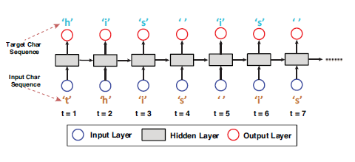
RNN- as a Text Generative Model
Focus on character level
The hidden layer to capture the relationship between each input and characters prior to it
Conditional probability P (xt+1|(x1, . . . , xt))
Temperature controls the novelty of generated text (0 to 1)
Lower temperatures – less diverse text
Higher temperatures- novel text

Slide 19
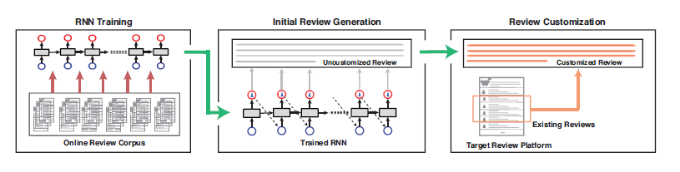
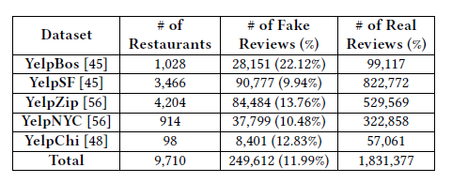
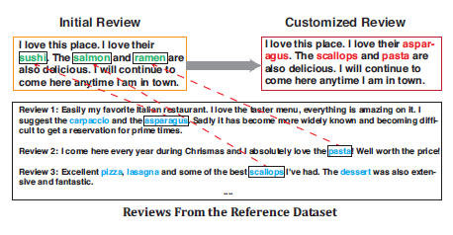
Problem – Attack Methodology
Training RNN on a review corpus
Generate initial reviews
Review customisation
Capture context, and change words
Datasets – focussed on Yelp
Text of review, identity of restaurant and the score
Three datasets
Training (57M Words, 304 characters)
Ground-Truth ( table below)
Attack (aligned with ground-truth)
Attack
Ground Truth
Training
Attack

Slide 20
AI generated fake reviews (Juuti et al. )
Juuti et al. utilized Neural Machine Translation (NMT) to generate context-appropriate restaurant reviews.
They include an encoder network and a decoder network, which are jointly optimized to produce a translation of one sequence to another.
The encoder rolls over the input data in sequence and produces one n-dimensional context vector representation for the sentence.
The decoder then generates output sequences based on the embedding vector and an attention module, which is taught to associate output words with certain input words.
The generation typically continues until a specific EOS (end of sentence) token is encountered. The review length can be controlled in many ways, e.g. by setting the probability of generating the EOS token to zero until the required length is reached.
Notes:
Juuti M, Sun B, Mori T, Asokan N. Stay on-topic: Generating context-specific fake restaurant reviews. InEuropean Symposium on Research in Computer Security 2018 Sep 3 (pp. 132-151). Springer, Cham.
1) the ability tolearnhow to associate context(keywords) to reviews

Slide 21
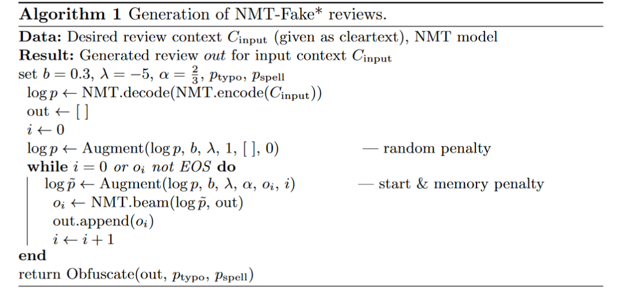
AI generated fake reviews (Juuti et al. )
B: controls how much of the vocabulary is forgotten
Λ: is a soft penalty of including “forgotten” words in a review
Notes:
Bernoulli penalties to language modelTo avoid generic sentences components,we augment the default language modelp(·) of the decoder by
Wetried several forms of added randomness, and found that adding constant penal-ties to arandom subsetof the target words resulted in the most natural sentenceflow. We call these penaltiesBernoulli penalties, since the rando m variables arechosen as either 1 or 0 (on or off)
with increasing values ofb: visibly, the restaurant reviews become more extreme.This occurs because a large portion of vocabulary is “forgotten”. Reviews withb≥0.7 contain more rare word combinations, e.g. “!!!!!” as punctuation, andthey occasionally break grammaticality (”experience was awesome”). Reviewswith lowerbare more generic: they contain safe word combinations like “Greatplace, good service” that occur in many reviews. Parameterλ’s is more subtle:it affects how random review starts are and to a degree, the discontinuationbetween statements within the review. We conducted an Amazon MechanicalTurk (MTurk) survey in order to determine what kind of NMT-Fake reviews areconvincing to native English speakers. We describe the survey and results in thenext section

Slide 22
Sample of Data
5 Public House Las Vegas NV Gastropubs Restaurants > Excellentfood and service . Pricey , but well worth it . I would recommendthe bone marrow and sampler platter for appetizers .
The order[rating name city state tags]is kept constant. Training the model conditions it to associate certain sequences of words in the input sentence with others in the output.

Slide 23
AI generated fake reviews (Juuti et al. )
Despite successfully deceiving human readers, they were able to detect generated reviews with a very high F1-score of 97%, using an AdaBoost classifier trained on words, POS n-grams, dependency tag n-grams, and NLTK’s readability features.

Slide 24
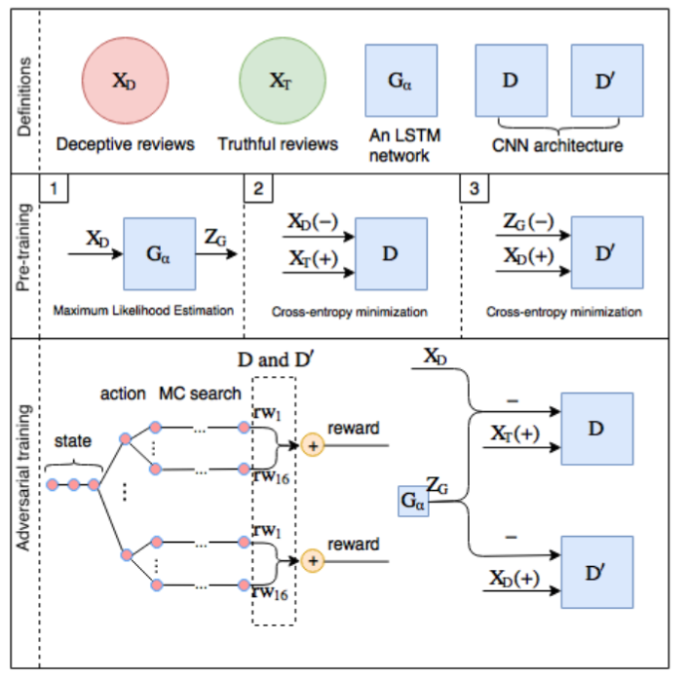
Detecting Deceptive Reviews using GAN
D :
Distinguish between X_{T} or (X_{D} U Z_{G})
Guide generator to produce sample similar to X_{T}
D’:
Distinguish between X_{D} or Z_{G}
Guide generator to produce sample similar to X_{D}

Slide 25
Recent developments in automatic text generation demonstrate that automating the task of fake reviewing is an increasing threat.

Slide 26
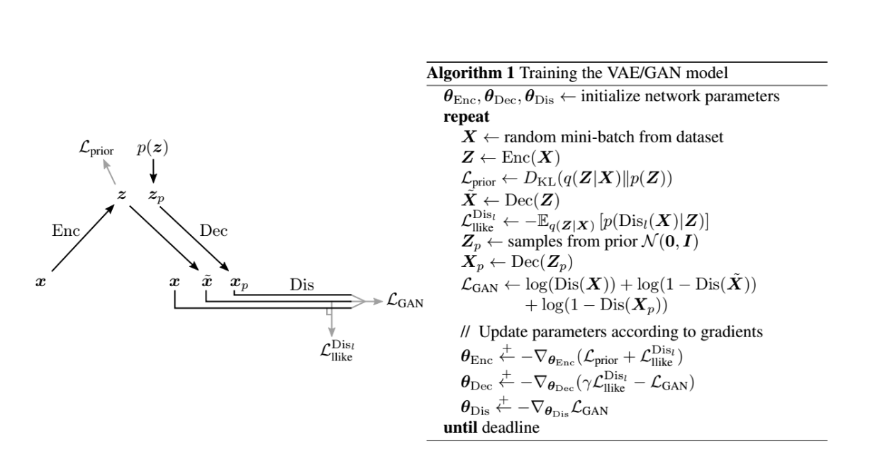

Slide 27
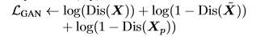
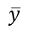


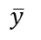
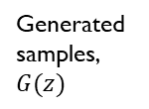
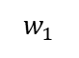
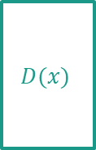


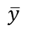
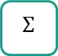
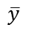
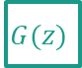
Preliminary Idea.
Input: POS tags associated with reviews
Reconstruct
reviews (x_tilde)
Generated samples, $G(z)$
Sample of
(y)
Discriminator
$$\overline{y}$$
$$G(z)$$
$$D(x)$$
$$\overline{y}$$
$$w_{1}$$
$$x$$
1
$μ$
0
$$\overline{y}$$
Data samples, x
FAKE
REAL
$$Σ$$
$$\overline{y}$$
Decoder(generator)
Generate using
SeqGAN based on
RL
Discriminator
$$G(z)$$
$$D(x)$$
Encoder
$$x$$
0
1
Data samples, x
FAKE
REAL
Reviews
Loss Generator :
Policy Gradient mode -
Loss encoder : prior + Cross entropy Disc(Reconstruct reviews , reviews)

Slide 28
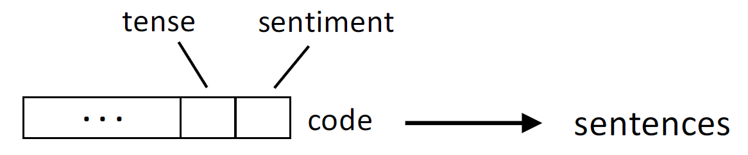

Input: POS tags associated with reviews
Reconstruct
reviews (x_tilde)
Generated samples, $G(z)$
Sample of
(y)
Discriminator
$$\overline{y}$$
$$G(z)$$
$$D(x)$$
$$\overline{y}$$
$$w_{1}$$
$$x$$
1
$μ$
$$code$$
0
$$\overline{y}$$
Data samples, x
FAKE
REAL
$$Σ$$
$$\overline{y}$$
Decoder(generator)
Generate using
SeqGAN based on
RL
Discriminator
$$G(z)$$
$$D(x)$$
Encoder
$$x$$
0
1
Data samples, x
FAKE
REAL
Reviews
Loss Generator :
Policy Gradient mode -
Loss encoder : prior + Cross entropy Disc(Reconstruct reviews , reviews)

Slide 29
Thank you
Any question?

Slide 30
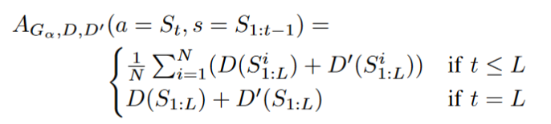
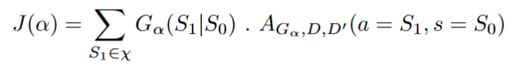

Slide 31
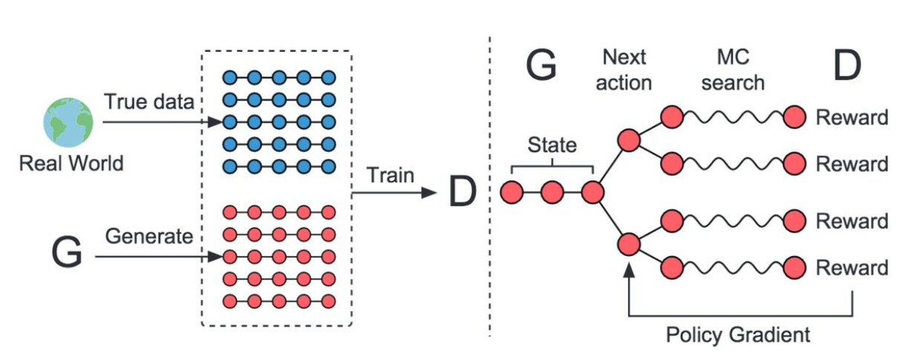

Slide 32
Refrences
Detecting Product Review Spammers using Rating Behaviors
Finding Unusual Review Patterns Using Unexpected Rules
Spotting Fake Reviewer Groups in Consumer Reviews
Opinion spam and analysis
Finding Deceptive Opinion Spam by Any Stretch of the Imagination
Review Graph based Online Store Review Spammer Detection
Merging Multiple Criteria to Identify Suspicious Reviews
Review Spam Detection via Temporal Pattern Discovery, Sihong Xie, Guan Wang, Shuyang Lin, Philip S. Yu
2012, SIGKDD
Spotting Fake Reviews via Collective Positive-Unlabeled Learning , 2014 IEEE International Conference on Data Mining
FAKE Review Detection,Arjun Mukherjee, Vivek V Venkataraman, Bing Liu, Natalie S. Glance, 2013
Collective Opinion Spam Detection, 2015 KDD
Automated Crowdturfing Attacks and Defenses in Online Review Systems, Yuanshun Yao, Bimal Viswanath, Jenna Cryan, Haitao Zheng, and Ben Y. Zhao, 2017 ACM SIGSAC Conference on Computer and Communications Security (CCS '17)
Reliable Fake Review Detection via Modeling Temporal and Behavioral Patterns, Xian Wu, Yuxiao Dong, Jun Tao, Chao Huang, Nitesh V. Chawla,2017 IEEE International Conference on Big Data (BIGDATA)
Notes:
http://shebuti.com/collective-opinion-spam-detection/
srayana@cs.stonybrook.edu
http://shebuti.com/collective-opinion-spam-detection/
http://www.cs.stonybrook.edu/~datalab/
https://medium.com/@zhiwei_zhang/final-blog-642fb9c7e781

Slide 33
Challenge
the primary challenge that we face when using GANs for generating text, i.e., the non-differentiability of the picking operation at the output of the generator, which makes it hard to train the generator effectively using backpropagation.

Slide 34
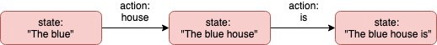
Formulation of problem
Let’s leave the whole idea of neural network based text generators aside for a moment and think of our text generator as an RL agent.
What would its states and actions be? One simple formulation would be to define the state s of the agent to be the “text generated so far” and the action a to be “choosing the next word” in the sentence. Therefore, the choice of actions is defined by our vocabulary of words.
The generation proceeds in this manner with the agent choosing an action (word) at each time step. When the agent finally chooses the “end of sentence” action, it reaches the end of an episode and receives a reward which tells it how good its state-action sequence (generated sentence) was. In our case, this reward will be provided by the discriminator network. So, we can view the discriminator as a continuously improving reward function for our agent.

Slide 35
A policy is a function 𝜋(a | s, 𝜃) parameterized by 𝜃, that outputs a probability distribution over all the actions a given the current state s of the agent.
An agent generating text based on a policy 𝜋 samples from the set of actions according to the distribution returned by the policy (As a side-note, this gives us some built-in non-determinism that helps our agent in exploring state space, i.e., it doesn’t just generate the same high reward sentence over and over).
Building a good text generation agent now boils down to the task of finding the optimal policy 𝜋*. In other words, we want to find the optimal parameter 𝜃* that maximizes some (will be defined later) performance measure J(𝜃) of our agent.

Slide 36
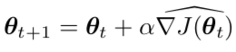
Policy Gradients
Policy gradient methods are a particular class of policy optimization methods for finding the optimal parameter 𝜃*, that are based on finding the gradient of some performance measure J(𝜃) with respect to 𝜃. So, in order to find the optimal parameter, we perform gradient ascent on J as:
where the caret (^) on the gradient signifies that it is an approximation of the gradient.
So, how do we go about approximating the gradient? The answer is provided by the policy gradient theorem. T

Slide 37
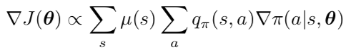
Policy Gradients
𝜇(s) is a measure of how often the agent is likely to visit state s (across a lot of episodes) if it follows policy 𝜋. It is normalized by its sum over all states to give us a probability measure. You might be wondering how we could possibly calculate that, but don’t worry, it conveniently disappears.
q(s, a) is a measure of the “quality” (can be thought of as value) of action a taken from state s. Now, the RHS of the policy gradient theorem is a summation over all states and all actions. But, we want an efficient algorithm that will estimate this quantity using just a single sample (S_t, A_t), i.e., the state and action taken at time step t while following the policy 𝜋. This is where the REINFORCE algorithm for calculating policy gradients comes in handy

Slide 38
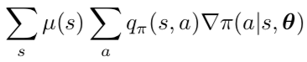
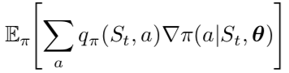
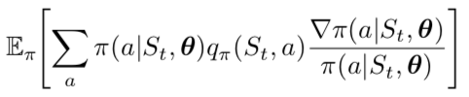
Reinforcment Algorithm
Notice that 𝜇(s) is essentially the probability of state s occurring while following policy 𝜋. So, the outer summation is just an expectation (over 𝜋) of the value of the inner summation.
So why not do the same thing for the inner summation? To do this, we multiply and divide by 𝜋(a | S_t, 𝜃).

Slide 39
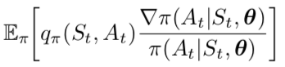
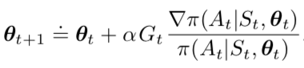
𝜋(a | S_t, 𝜃) is the probability distribution over the actions at state S_t. So again, the summation looks like an expectation and we can reduce it to:
That’s it! We can estimate this form of the gradient using just the one sample (S_t, A_t) that we get at time step t while generating text using the current policy 𝜋. Replacing q_𝜋(S_t, A_t) with G_t, we get the final form of the REINFORCE update.

Slide 40
Ok, what’s G_t? It can be thought of as the cumulative reward that we can expect while following the policy 𝜋 from time step t until the end of the episode.
Understanding the REINFORCE update
Intuitively, 𝛻𝜋(A_t | S_t, 𝜃_t) is a vector that tells us the direction of maximum increase of the probability of taking action A_t when we encounter state S_t again. So, it makes sense that we move our parameter 𝜃 in that direction.
The amount by which we move in that direction is proportional to G_t, which basically means that if our expected reward is higher, we move by a larger amount in that direction.

Slide 41
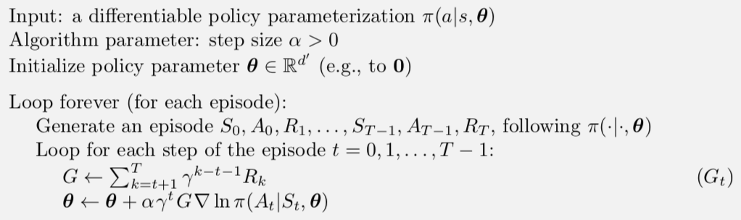

Slide 42
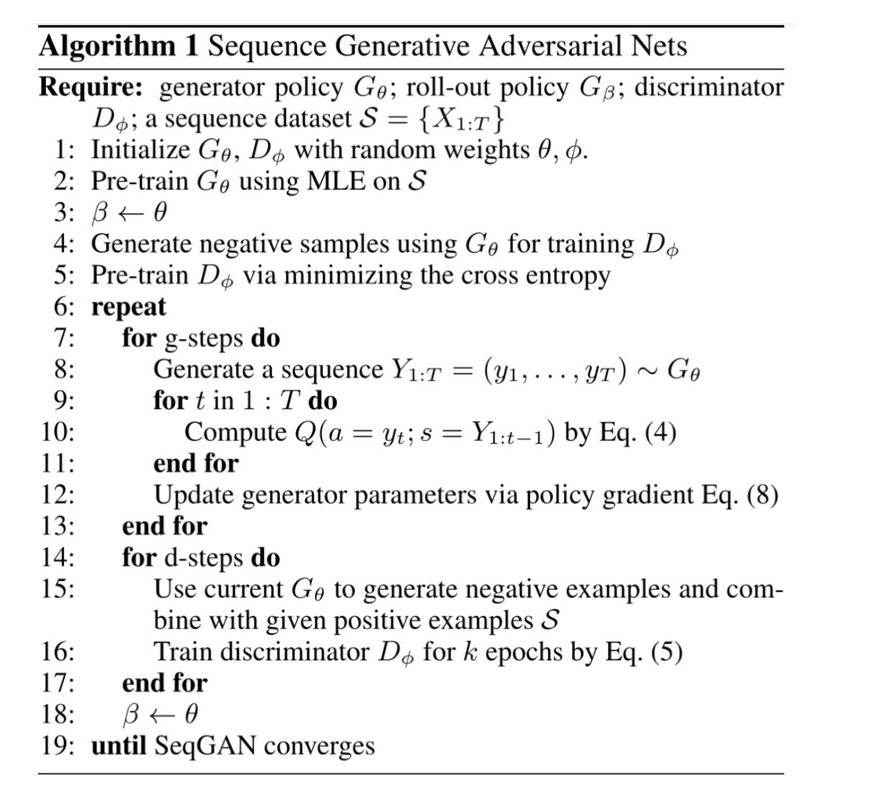

Slide 43
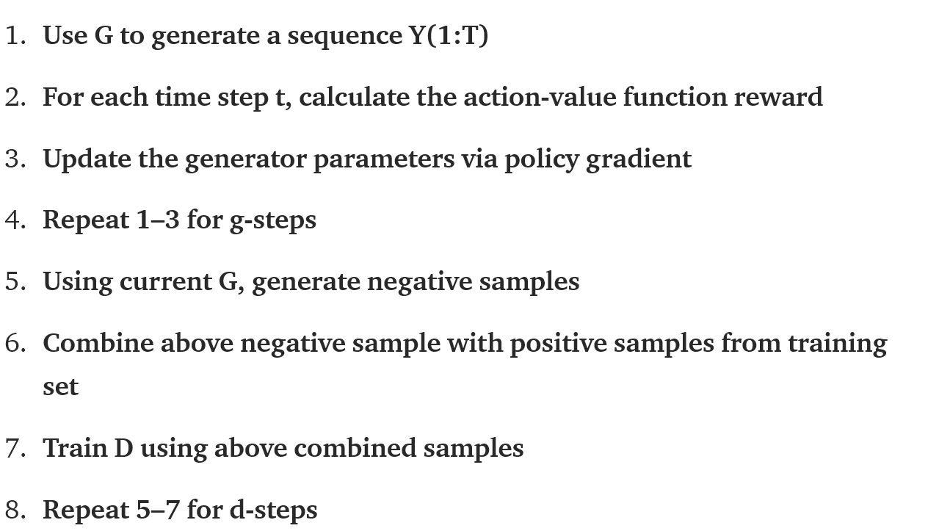

Slide 44
In SeqGANs, the generator is treated as an RL agent.
State: Tokens generated so farAction: Next token to be generatedReward: Feedback given to guide G by D on evaluating the generated sequence

Slide 45
As the gradients cannot pass back to G due to discrete outputs, G is regarded as a stochastic parametrized policy. The policy is trained using policy gradient.
In a stochastic paramterized policy, the actions are drawn from a distribution that parameterizes your policy. For eg., your action may be sampled from a normal distribution whose mean and variance will be predicted by your policy. When you draw from this distribution and evaluate your policy, you can move your mean closer to samples that lead to higher reward and farther from samples that lead to lower reward. The policy gradient integrates over both state and action spaces, whereas in the deterministic case it only integrates over the state space.

Slide 46
Now that we have all the pieces we need, we are finally ready to construct a GAN for text generation.
Let’s look at the easiest part first — the discriminator network. The discriminator network simply takes a sentence as input and outputs a value that signifies how “real” the sentence looks. This can be done using a CNN/RNN based model. Note that this value output by the discriminator will also be used as the reward corresponding to the input sentence, and will be provided back to the generator to update its policy at the end of each episode.
What about the generator? It is going to represent the parameterized policy 𝜋(a | s, 𝜃), where 𝜃 corresponds to the parameters of the generator network which will be updated according to the REINFORCE algorithm given above. Therefore, the generator should be able to take a sequence of words as input and output a probability distribution over the next word. This can be achieved using an RNN by feeding in a word at each time step and obtaining the final hidden state. The final hidden state of the RNN is then mapped to a probability distribution using a feed-forward network followed by softmax.

Slide 47
the discriminator network. The discriminator network simply takes a sentence as input and outputs a value that signifies how “real” the sentence looks. This can be done using a CNN/RNN based model. Note that this value output by the discriminator will also be used as the reward corresponding to the input sentence, and will be provided back to the generator to update its policy at the end of each episode.
What about the generator? It is going to represent the parameterized policy 𝜋(a | s, 𝜃), where 𝜃 corresponds to the parameters of the generator network which will be updated according to the REINFORCE algorithm given above.
Therefore, the generator should be able to take a sequence of words as input and output a probability distribution over the next word. This can be achieved using an RNN by feeding in a word at each time step and obtaining the final hidden state. The final hidden state of the RNN is then mapped to a probability distribution using a feed-forward network followed by softmax.

Slide 48


There is still one piece left to clarify — the intermediate rewards R_k that we use to calculate G_t. As I mentioned above, the discriminator network provides a reward only at the end of the episode, i.e., after it looks at the entire generated sentence. So, where do we get the intermediate rewards from? The SeqGAN paper solves this issue using Monte-Carlo rollouts. Hold on, you don’t have to know what that means, the idea is actually pretty straightforward.
The idea behind Monte-Carlo rollouts is to start from the current state S_t, and simulate N (10–20) different episodes following the current policy 𝜋. In our case, this means generating N different sentences whose prefix is the incomplete sentence corresponding to state S_t.

Slide 49
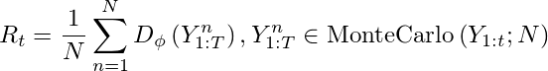
Then, we get the rewards corresponding to these N sentences using the discriminator and average them out to get the expected reward R_t at time step t. This makes sense because it tells us what reward to expect when we proceed till the end from state S_t.

Slide 50
Issue ith RL-based methods
Since we are just using a few samples to estimate the gradient of the policy at each time step, there is a very high variance in the gradient estimate from episode to episode. This makes the training process unstable and convergence is very slow. The SeqGAN paper attempts to speed-up the training by pre-training both the generator and discriminator as standard language models using MLE.
Also, policy gradient methods tend to converge to a local maxima, especially in cases such as ours where the state-action space is huge. Note that we have a choice between |V| actions at each time step, where V is our vocabulary (could be of the order of 100,000).

Slide 51
Weakness SeqGAN
Huge search space: If the vocabulary is 5000, and the text length is 10, the text’s number will beup to , it needs many attempts to find a good policy.

Slide 52
LeakGAN
LeakGAN that borrows from recent advances in hierarchical reinforcement learning to provide richer information from the discriminator to the generator
a generator is an LSTM and it contains a high-level MANAGER module and low-level WORKER module;
in each step, the MANAGER receives a high-level feature representation extracted by the discriminator and uses it to form the guiding goal for the WORKER module in that timestep.

Slide 53
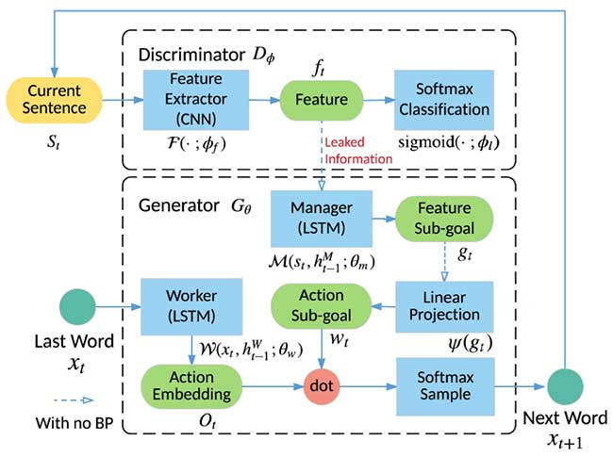

Slide 54
Given generator Gθ (bottom dotted-line) and Dϕ (upper dotted-line), the generator is broken into a Manager (M) and a Worker module (W). To generate the next word xt+1, the current sentence St is first fed into feature extractor F inside Dϕ. The extracted feature then leak to manager in the generator to compute a goal vector projected to action space wt by a linear projection ψ. The worker computes the probability distribution of next action to take Ot given the previous word xt then adjust its distribution by element-wise dot with wt to get final distribution.
In a recent survey [36], Lu et al. observe that all methods above suffer from serious mode-collapse by measuring self-BLEU score, which is calculated by picking one generated sample then compute average BLEU score over generated samples collection.
HOW DO WE EVALUATE OUR TEXT GENERATION MODEL?
For text generation model discussed in this post, a specific aspect is whether the model suffers from mode-collapse (lack diversity) in addition to the text quality. A naive approach to measure the diversity is to count unique n-gram. However, improving such n-gram metric does not necessarily enhance the diversity as discussed in MaskGAN. The diversity of text generation is a less addressed issue in the recent literature although a few very recent work start to explore it [43]. Moreover, there is no existing metrics in text generation analogous to Inception-Score [11] or Fréchet Inception Distance [44] in conventional GAN that can reflect the diversity and quality of generated images, which might suggest a direction to explore

Slide 55
Next, given the goal embedding produced by the MANAGER,
the WORKER first encodes current generated words
with another LSTM, then combines the output of the LSTM
and the goal embedding to take a final action at current state.
As such, the guiding signals from D are not only available
to G at the end in terms of the scalar reward signals, but
also available in terms of a goal embedding vector during
the generation process to guide G how to get improved.

Slide 56
For Generator, we train the Manager and Worker independently to let them focus on their own task•Worker is trained like SeqGAN

Slide 57
Metrics
N-gram based metrics. Typical metrics that researchers have used to evaluate textual GANs are the number of unique n-grams Xu et al. (2018) and dataset level BLEU scores Yu et al. (2016); Guo et al. (2017). We use BLEU4 throughout the paper since we found the results to be similar for different sizes of N-grams. While they do give some insight into a model’s behavior they have a number of drawbacks. The main criticism is that they do not capture semantic variations in generated texts and can only detect relatively simple problems with syntax.
Language Model score. Another feasible way to evaluate a model is to estimate the likelihood of samples under a pretrained Language Model. This, however, has a drawback that a model that always generates a few highly likely sentences will score very well. Despite this, it is still a useful metric reacting only on the quality of generated samples and thus is a good proxy for a model’s precision.
Reverse Language Model score. A more general approach is to train a Language Model on samples from a model and then evaluate its performance on a held out set of real texts Zhao et al. (2017). In this setting, however, the score is biased due to two factors. One is model bias caused by the imperfection of the LM that may not be good enough to model the data distribution. The other is data bias caused by the fact that we use a data sample to train a LM that will serve as a proxy for the true data distribution.

Slide 58
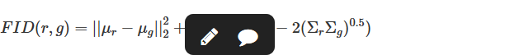
Frechet InferSent Distance. Another approach to evaluate a generative model is through an embedding model. Originally proposed in the computer vision community, Frechet Inception Distance (FID) Heusel et al. (2017) computes the distance between distributions of features extracted from real and generated samples. Inception refers to a specific image classifier architecture Szegedy et al. (2015). To evaluate FID, the authors first make an assumption that features extracted by a classifier are normally distributed. They then propose to sample a number of data points from real and estimated distributions and compute
where (μr,Σr) and (μg,Σg) are the mean and covariance of embeddings of samples from data and model distributions respectively. While researchers have pointed out that FID has its drawbacks, namely that it is a biased metric Lucic et al. (2017); Binkowski et al. (2018) and it makes unnecessary assumptions about feature distributions Binkowski et al. (2018), it is a widely accepted metric in the Computer Vision community. In this work we adapt this metric for text by using InferSent text embedding model Conneau et al. (2017), which is a bidirectional LSTM with max pooling trained in a supervised manner. Unless otherwise noted, we use InferSent embedding model to compute sentence embeddings. However, we note that training a sequence embedding model is an ongoing research which will likely affect the quality of the discussed metric. Thus we omit specific embedding model from the metric name refer to it as Frechet Distance (FD).

Slide 59
Human Evaluation. Since the goal of a text generation model is to create samples that are indistinguishable from real ones, it is important to also perform human evaluation to assess their quality. We send 200 samples from each model (uniformly sampling from random restarts) to the human raters (using 3 raters per sample) asking them to score if the presented sentence is grammatically correct and understandable on a scale from 1 to 5 (with being 5 the best score).

Slide 60
Toward Controlled Generation of Text

Slide 61
Text samples are discrete and non-differentiable
• Disables holistic discriminators that evaluate generated whole sentences
• Reconstruction-based methods (LM, VAEs) lose holistic view of whole
sentences
• This work:
• Enables attribute discriminator through deterministic softmax approximation

